Slide 1
Discrete probability distributions
Binomial distribution, Poisson's distribution-Illustrative examples

Slide 2
Discrete probability distributions
A discrete probability distribution is a probability distribution of a categorical or discrete variable.
Discrete probability distributions only include the probabilities of values that are possible. In other words, a discrete probability distribution doesn’t include any values with a probability of zero. For example, a probability distribution of dice rolls doesn’t include 2.5 since it’s not a possible outcome of dice rolls.
The probability of all possible values in a discrete probability distribution add up to one. It’s certain (i.e., a probability of one) that an observation will have one of the possible values.

Slide 3
Discrete probability distributions
Discrete probability distributions are graphs of the outcomes of test results, such as a value of 1, 2, 3, true, false, success, or failure. Investors use discrete probability distributions to estimate the chances that a particular investing outcome is more or less likely to happen.
These distributions model the probabilities of random variables that can have discrete values as outcomes. For example, the possible values for the random variable X that represents the number of heads that can occur when a coin is tossed twice are the set {0, 1, 2}

Slide 4
Important Points
A discrete probability distribution counts occurrences that have countable or finite outcomes.
Discrete distributions contrast with continuous distributions, where outcomes can fall anywhere on a continuum.
Common examples of discrete distribution include the binomial, Poisson, and Bernoulli distributions.
These distributions often involve statistical analyses of "counts" or "how many times" an event occurs.
In finance, discrete distributions are used in options pricing and forecasting market shocks or recessions.

Slide 5
Calculation of Discrete Probability Distribution
How you calculate a discrete probability distribution depends on your test, what you're trying to measure, and how you measure it. For instance, if you're flipping a coin twice, the possible combinations are:
Tails/tails (TT)
Heads/tails (HT)
Tails/heads (TH)
Heads/heads (HH)
Because you're flipping the coin twice and there are two possible outcomes, there are four possibilities.

Slide 6
Calculation of Discrete Probability Distribution
This works similarly for rolling two dice because the results of a dice roll are discrete. There are 36 possibilities because each die has six faces, but there cannot be a result of one since the lowest number on each die is one. So the lowest result you can get is two, and the highest is 12. Many of the combinations will repeat, just as in the coin example—so the more possibilities that repeat, the more instances will be graphed.
If you add the figures for dice roll results together, you have one instance where the result is two and one where it is 12—creating odds of one in 36 for the numbers two and 12.

Slide 7
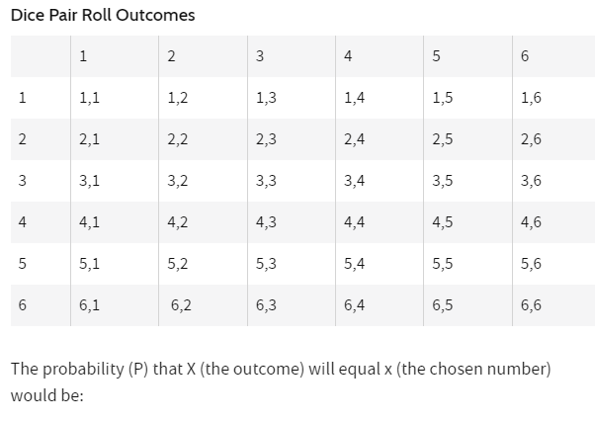
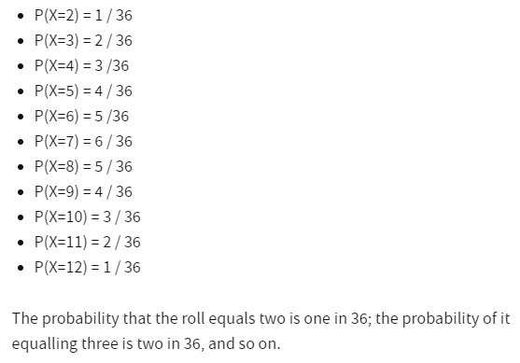
Calculation of Discrete Probability Distribution

Slide 8
How Do You Know If a Distribution Is Discrete? A distribution is discrete if its random variable can only take on a finite or countable number of values. What Are the 2 Requirements for a Discrete Probability Distribution? The two requirements for a discrete probability distribution are: 1. Probability of each possible outcome must be between 0 and 1. 2. Sum of the probabilities of all possible outcomes must be equal to 1.

Slide 9
Binomial Distribution
In probability theory and statistics, the binomial distribution is the discrete probability distribution that gives only two possible results in an experiment, either Success or Failure.
The binomial distribution is a discrete probability distribution that represents the probabilities of binomial random variables in a binomial experiment. The binomial distribution is defined as a probability distribution related to a binomial experiment where the binomial random variable specifies how many successes or failures occurred within the sample space.
For example, if we toss a coin, there could be only two possible outcomes: heads or tails, and if any test is taken, then there could be only two results: pass or fail.
This distribution is also called a binomial probability distribution.

Slide 10
Binomial Distribution
In binomial probability distribution, the number of ‘Success’ in a sequence of n experiments, where each time a question is asked for yes-no, then the boolean-valued outcome is represented either with success/yes/true/one (probability p) or failure/no/false/zero (probability q = 1 − p).
A single success/failure test is also called a Bernoulli trial or Bernoulli experiment, and a series of outcomes is called a Bernoulli process.
For n = 1, i.e. a single experiment, the binomial distribution is a Bernoulli distribution.
The binomial distribution is the base for the famous binomial test of statistical importance.

Slide 11
Negative Binomial Distribution
In probability theory and statistics, the number of successes in a series of independent and identically distributed Bernoulli trials before a particularized number of failures happens. It is termed as the negative binomial distribution.
Here the number of failures is denoted by ‘r’. For instance, if we throw a dice and determine the occurrence of 1 as a failure and all non-1’s as successes.

Slide 12
Binomial Distribution Examples
Binomial distribution gives the possibility of a different set of outcomes. In real life, the concept is used for:
Finding the quantity of raw and used materials while making a product.
Taking a survey of positive and negative reviews from the public for any specific product or place.
By using the YES/ NO survey, we can check whether the number of persons views the particular channel.
To find the number of male and female employees in an organisation.
The number of votes collected by a candidate in an election is counted based on 0 or 1 probability.

Slide 13
What is a Binomial experiment?
A binomial experiment represents a binomial random variable X which counts the number “n” of successes in N trials when each trial has only two outcomes, success, and failure.
Thus, an experiment could consist of 1 trial, 5 trials, 10 trials, 20 trials, etc., an experiment could be tossing a coin 10 times (10 trials), taking 10 items for examining whether the items are defective, etc.
The requirements for a random experiment to be a Binomial experiment are as follows:
A fixed number (n) of trials
Each trial must be independent of the others
Each trial must result in one of the two possible outcomes, called “success” (the outcome of interest) or “failure”.
There is a constant probability (p) of success for each trial, the complement of which is the probability (1 – p) of failure, sometimes denoted as q = (1 – p)

Slide 14
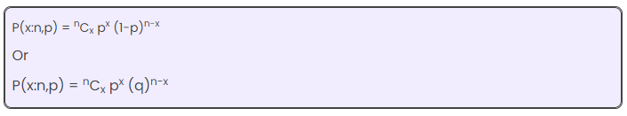
Binomial Distribution Formula
The binomial distribution formula is for any random variable X, given by;
Where,
n = the number of experiments
x = 0, 1, 2, 3, 4, …
p = Probability of Success in a single experiment
q = Probability of Failure in a single experiment = 1 – p
The binomial distribution formula can also be written in the form of n-Bernoulli trials, where ^{n}C_{x} = n!/x!(n-x)!. Hence,
P(x:n,p) = n!/[x!(n-x)!].p^{x}.(q)^{n-x}

Slide 15
Binomial Distribution Mean and Variance
For a binomial distribution, the mean, variance and standard deviation for the given number of success are represented using the formulas
Mean, μ = np
Variance, σ² = npq
Standard Deviation σ= √(npq)
Where p is the probability of success
q is the probability of failure, where q = 1-p

Slide 16
Binomial Distribution Vs Normal Distribution
The main difference between the binomial distribution and the normal distribution is that binomial distribution is discrete, whereas the normal distribution is continuous.
It means that the binomial distribution has a finite amount of events, whereas the normal distribution has an infinite number of events.
In case, if the sample size for the binomial distribution is very large, then the distribution curve for the binomial distribution is similar to the normal distribution curve.

Slide 17
Properties of Binomial Distribution
The properties of the binomial distribution are:
There are two possible outcomes: true or false, success or failure, yes or no.
There is ‘n’ number of independent trials or a fixed number of n times repeated trials.
The probability of success or failure remains the same for each trial.
Only the number of success is calculated out of n independent trials.
Every trial is an independent trial, which means the outcome of one trial does not affect the outcome of another trial.

Slide 18
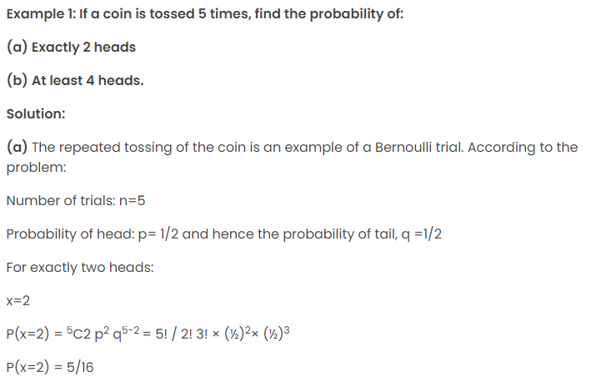
Binomial Distribution Examples

Slide 19
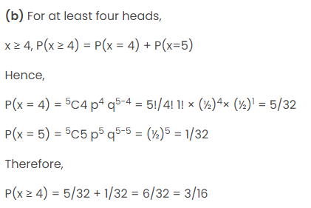
Binomial Distribution Examples

Slide 20
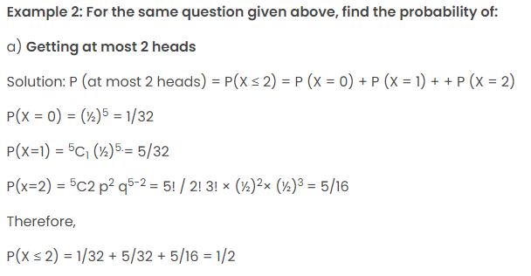
Binomial Distribution Examples

Slide 21
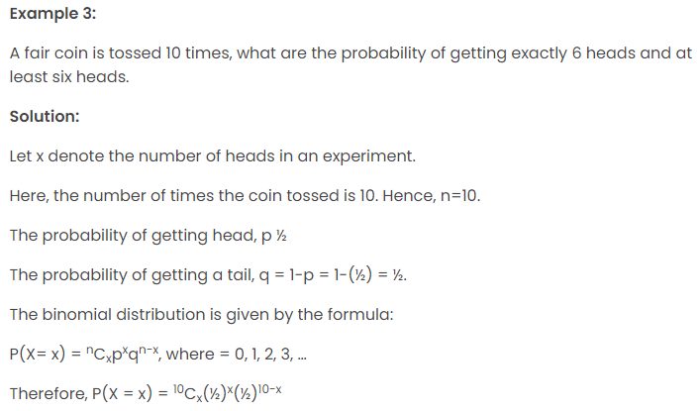
Binomial Distribution Examples

Slide 22
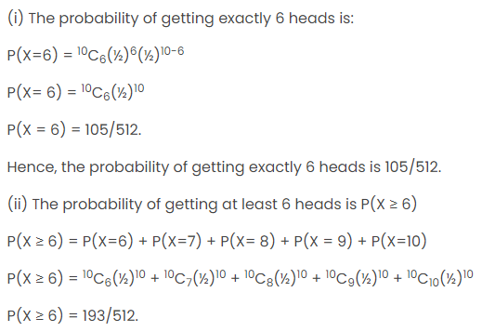
Binomial Distribution Examples

Slide 23
Poisson's distribution
In Statistics, Poisson distribution is one of the important topics. It is used for calculating the possibilities for an event with the average rate of value
A Poisson distribution is a discrete probability distribution. It gives the probability of an event happening a certain number of times (k) within a given interval of time or space.
The Poisson distribution has only one parameter, λ (lambda), which is the mean number of events
The Poisson distribution is a discrete probability function that means the variable can only take specific values in a given list of numbers, probably infinite.
A Poisson distribution measures how many times an event is likely to occur within “x” period of time. In other words, we can define it as the probability distribution that results from the Poisson experiment.
A Poisson experiment is a statistical experiment that classifies the experiment into two categories, such as success or failure. Poisson distribution is a limiting process of the binomial distribution.

Slide 24
Poisson's distribution
A Poisson random variable “x” defines the number of successes in the experiment. This distribution occurs when there are events that do not occur as the outcomes of a definite number of outcomes.
Poisson distribution is used under certain conditions. They are:
The number of trials “n” tends to infinity
Probability of success “p” tends to zero
np = 1 is finite

Slide 25
Poisson Distribution Formula
The formula for the Poisson distribution function is given by:
f(x) =(e^{– λ} λ^{x})/x!
Where,
e is the base of the logarithm
x is a Poisson random variable
λ is an average rate of value

Slide 26
Poisson Distribution Mean and Variance
Assume that, we conduct a Poisson experiment, in which the average number of successes within a given range is taken as λ. In Poisson distribution, the mean of the distribution is represented by λ and e is constant, which is approximately equal to 2.71828.
Then, the Poisson probability is:
P(x, λ ) =(e^{– λ} λ^{x})/x!
In Poisson distribution, the mean is represented as
E(X) = λ.
For a Poisson Distribution, the mean and the variance are equal.
It means that E(X) = V(X)
Where,
V(X) is the variance.

Slide 27
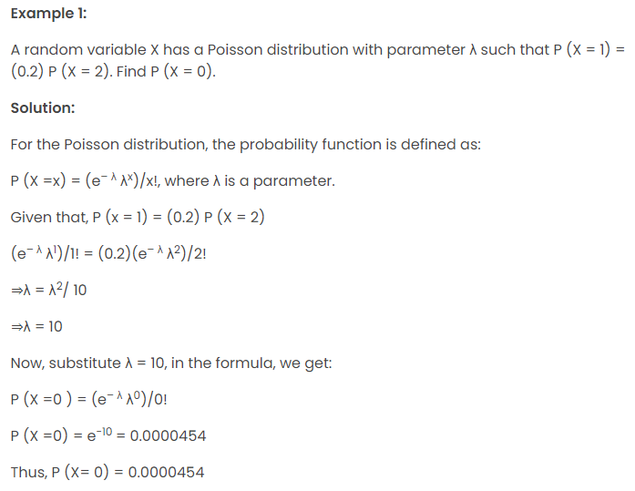
Poisson Distribution Examples

